Slide 1

INSIGHTFUL CODERS

Slide 2
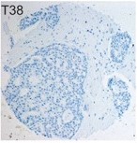
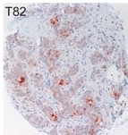
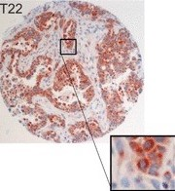
SURVIVAL ANALYSIS (HUMAN BREAST CANCER PREDICTION)
NEGATIVE
MODERATE
STRONG

Slide 3
PROBLEM OVERVIEW
➔Now a days, The most common cancer in women is Breast Cancer and Every year approximately 124 out of 100,000 women are diagnosed with breast cancer,
➔Early detection is the most effective way to reduce breast cancer deaths.
➔Early diagnosis requires an accurate and reliable procedure to distinguish between benign breast tumors from malignant ones .

Slide 4
DATA SET ATTRIBUTES
radius_mean
symmetry_mean
fractal_dimension_mean
texture_mean
perimeter_mean
area_mean
smoothness_mean
compactness_mean
concavity_mean Etc…..

Slide 5
PROBLEM STATEMENT
The problem statement deals with the determination of tumors i.e , Malignant or Bengin . Based on the cell parameters such as radius_mean , area_mean etc the model predicts whether the the tumor is malignant or benign

Slide 6



CELL Types
MALIGNANT
BENIGN

Slide 7
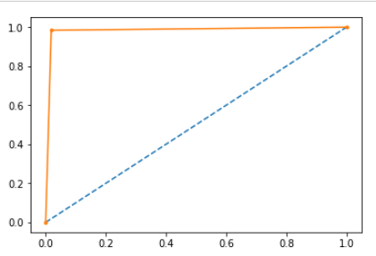
solution
LOGISTIC REGRESSION
ROC CURVE SCORE = 97.81%

Slide 8
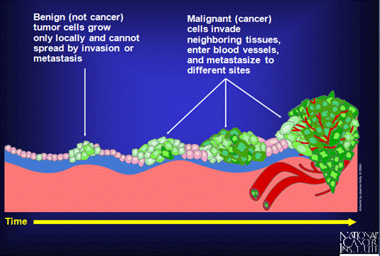
Benign versus malignant

Slide 9
Team members of insightful coders
Niveditha Nirmala
Patchipulusu Vaishnavi
Apoorva Sritha Reddy P
Ravela Durga Laasya
Divya Raman

Slide 10

Thank You For Watching

